Slide 1

Session 4.3 - Multi-Source Retrieval
The AlphaFund Dashboard System Design
Extract Once, Judge Many, Serve Beautifully.

Slide 2
High-Level Architecture
A robust, three-tier architecture connecting analysts to complex financial databases through a natural language interface.

Slide 3





System Tiers
Presentation
Orchestration
Retrieval
Streamlit frontend managing conversational UI, session memory, and multimodal browser rendering.
Gemini 2.5 Flash LLM acting as a Semantic Router, synthesizing and formatting down-stream queries.
Dual engines for deterministic structure (SQL) and unstructured hybrid retrieval (RAG).

Slide 4

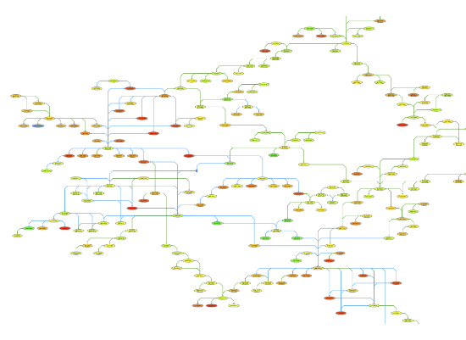
The Semantic Router
•
Replaces rigid if/else heuristics with LLM native function calling.
•
Ingests natural language to dynamically assess available tool schemas.
•
Identifies correct retrieval methods (e.g., SQL for "market cap", vector search for "CEO quotes").
•
Executes tools sequentially or in parallel, awaiting raw returns before synthesizing the final executive response.

Slide 5

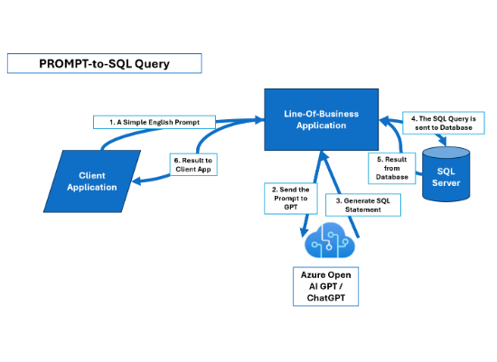
Engine A: Structured Data
•
Architecture: LangChain SQL Agent designed for deterministic math and aggregations.
•
Context Injection: The LLM is strictly prompted with the exact Data Definition Language (DDL) of the database.
•
Self-Correction: A hidden Reflexion loop catches invalid SQLite execution errors and forces query rewrites.
•
Circuit Breaker: Reflexion is hard-capped at 3 maximum retries to prevent infinite token-burn.

Slide 6
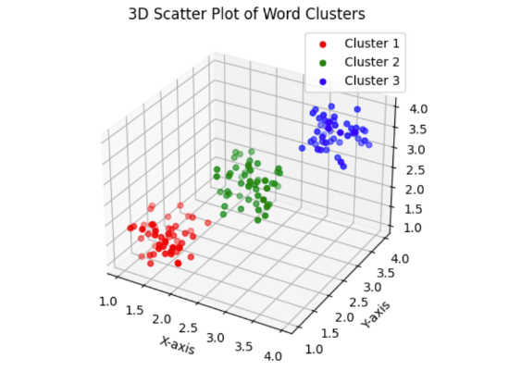


Engine B: Unstructured Hybrid RAG
•
Dense Vectors: FAISS utilizing text-embedding-004 for semantic conceptual matching.
•
Sparse Vectors: BM25 indexing for exact alphanumeric matching (tickers, invoices).
•
Contextual Compression: Trims irrelevant sentences inside winning chunks to save context.
•
Fusion: Reciprocal Rank Fusion (RRF) strips incompatible scores, ranking chunks purely on positional consensus.

Slide 7





Threat Model & Guardrails
Read-Only Execution
Regex Firewalling
Prompt Injection
Middleware blocks strings containing DROP, DELETE, UPDATE, ALTER, or GRANT prior to engine contact.
System prompts are hardcoded with DDL schema limits and few-shot examples to anchor output behavior.
The SQLite connection string is forcefully restricted to strict read-only permissions.

Slide 8
Limitations & Future Upgrades
Current Limitation | Architectural Description | Phase 2 Upgrade Path
Relational Blindness | The FAISS engine cannot understand multi-hop relationship chains across distinct corporate entities. | Introduction of Neo4j GraphRAG (Week 5)
Fragile Prompting | Reliance on manual prompt engineering, which is highly brittle to underlying LLM model updates. | Algorithmic prompt compilation via DSPy (Week 6)
Linear Routing | The router can only execute isolated tools and cannot natively reason through cyclical problems. | Refactoring into a stateful LangGraph Agent (Week 7)

Slide 9
Questions?
End of Architecture Briefing.

